Slide 1
Focus group meeting date
dr. Marinella Offerman
drs. Arta Hoesseini

Slide 2
Welcome & aim
Aim: to improve head and neck cancer patient care for future patients
We want to learn from your experiences: you can say anything you want!
Although there are some similarities, your situation and treatment is not identical with other patients in this room
Data will be anonymised
Turn off mobile phones

Slide 3
Agenda
19:00 welcome & aim
19:10 treatment decision consultation
19:30 shared decision making
19:40 life-expectancy (1)
20:00 break
20:10 life-expectancy (2)
21:20 closing
21:30 end

Slide 4
Time line
Consult GP / other hospital
intake
EMC
treatment
follow-up
symptoms
treatment
decision
consultation
referral
EMC
present

Slide 5
Time line
Consult GP / other hospital
intake
EMC
treatment
follow-up
symptoms
treatment
decision
consultation
referral
EMC
present

Slide 6
What do you think is a good treatment proposal?

Slide 7

Shared Decision Making
Patient & doctor decide together

Slide 8
To what extent do you want to be involved by your doctor when it comes to treatment choices?
Patient and doctor should decide together
The patient decides
The doctor decides

Slide 9

Life-expectancy
Not always discussed
Hard to predict → probability
One of the ways to discuss this is in a ‘’qualitative manner’’, general terms like: ‘the cancer is curable’
Another way is quantitative, like specific numbers or percentages

Slide 10
To what extent do you think it is important to receive information about your life expectancy?
Not at all important
Not important
Somewhat important
Very important

Slide 11
Do you think that life-expectancy should be discussed with each patient?

Slide 12
BREAK (20:00 – 20:10)

Slide 13
Life-expectancy
A specific way to discuss life-expectancy is with numbers / percentages
Percentage of patients who are alive at 2-, 5- or 10-years after treatment
Probability calculation, large group of patients with different characteristics

Slide 14
Life-expectancy
Example: a patient with a 5-years survival probability of 70%
=
the probability that after 5 years 70 out of 100 patients are still alive
=
the probability that the patients is alive after 5 years is 70%

Slide 15
In case we have these survival chances, should the doctor share these with the patient?

Slide 16
Which view would you prefer?

Slide 17
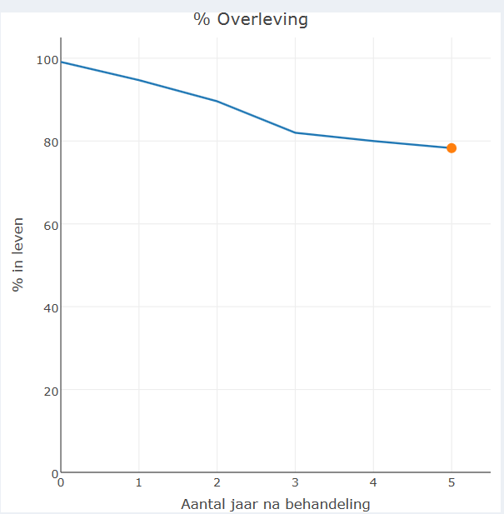
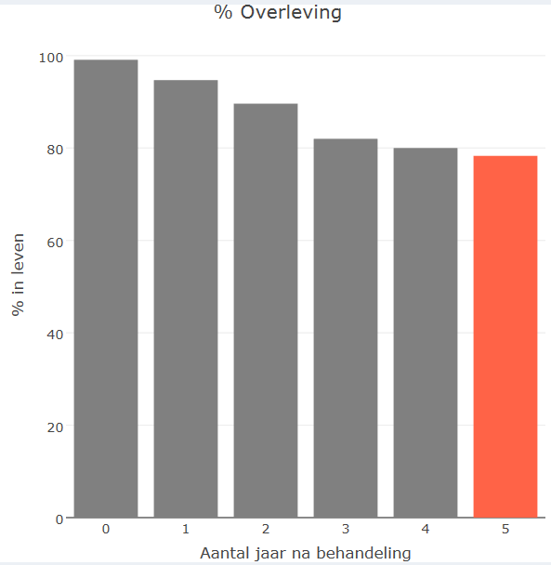
5-year survival rate

Slide 18
5-year survival rate

Slide 19

5-year survival rate
70% in leven 30% overleden

Slide 20
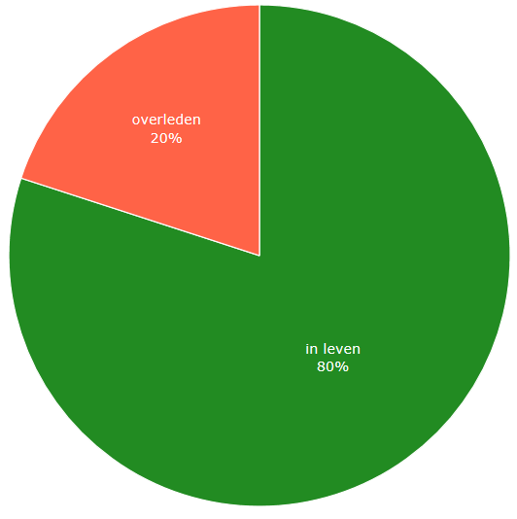
5-year survival rate

Slide 21
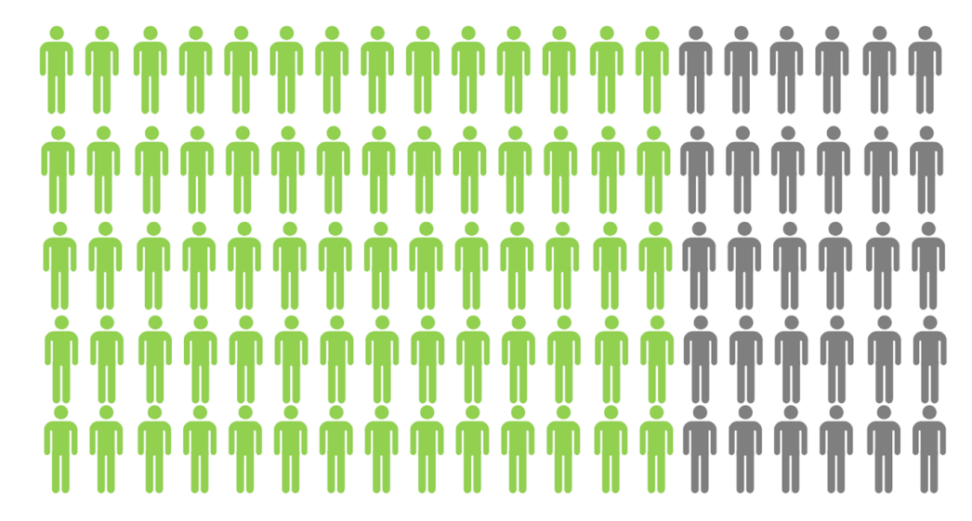
5-year survival rate
70% in leven 30% overleden

Slide 22
What would you prefer:
  Only verbal explanation of the %
  OR
  Verbal explanation and showing a chart

Slide 23
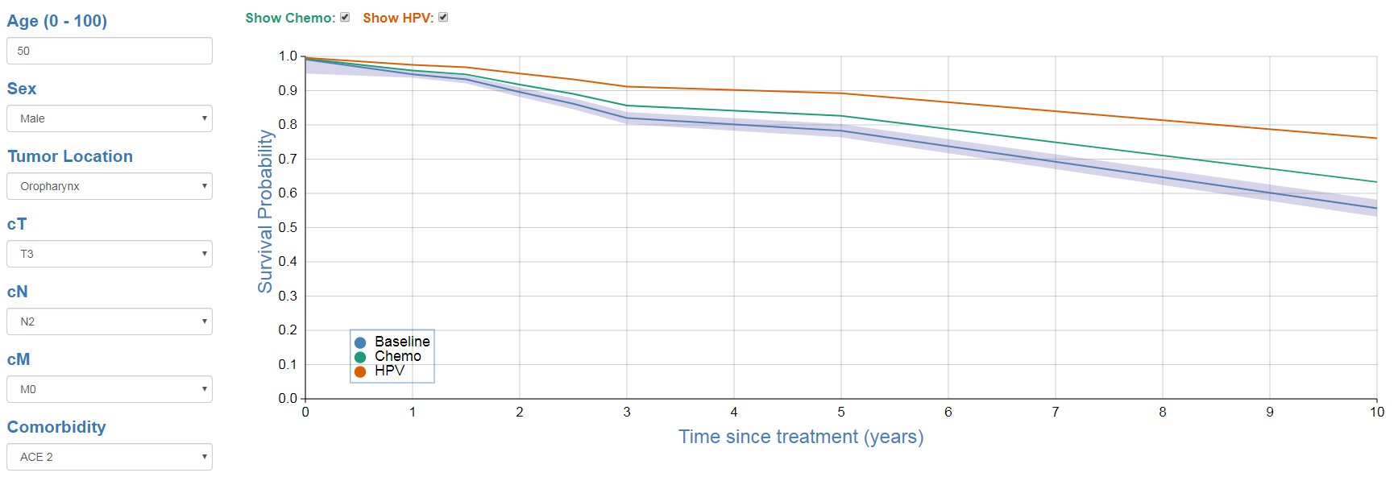
Model
Notes:
www.oncologic.com

Slide 24
What do you think of this model?

Slide 25
What would you change?
Do you think you would be better informed with the information in this model?
Do you think that the information in this model would be appropriate for everyone?

